Slide 1
Formal Modelling of Cruise Control System Using Event-B and Rodin Platform
Avian Silviu Gabriel
Ioan Tudor Alexandru
Mitrica Octavian

Slide 2
Formal modelling
A formal model is a model which description is complete and non-ambiguous for precisely defining, understanding and reasoning used when designing complex systems.
The paper “Formal Modelling of Cruise Control System Using Event-B and Rodin Platform” uses Event-B and Rodin platform for a case study of a cruise control system for a hybrid propulsion vehicle and an electric bicycle.

Slide 3
Formal modelling
The goal of formal modelling is to develop a rigorous framework with which you can challenge and test your primary results.
At this point in your data analysis, you’ve stated and refined your question, you’ve explored the data visually and maybe conducted some exploratory modeling.
The key thing is that you likely have a pretty good sense of what the answer to your question is, but maybe have some doubts about whether your findings will hold up under intense scrutiny. Assuming you are still interested in moving forward with your results, this is where formal modeling can play an important role.

Slide 4
Introduction
The e-Bike system considered as case study for this paper includes other propulsion control features including:
Pedal Assist (PA; the electric drive system provides torque assist proportional with the user input);
Pedal Charge (PC; the electric drive system operates as a generator, using the bike in this mode to exercise to charge the battery).
Cruise control system also interacts with the brake system of the e-Bike.
From a system design perspective, the validation of the operational safety of the system is crucial. An example of an event that could lead to safety issues is the activation of the cruise control without the user request.

Slide 5
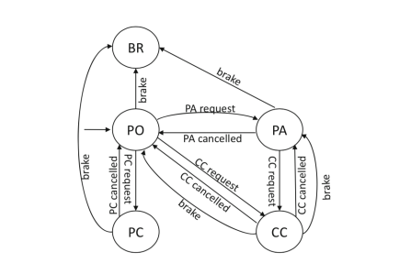
The state machine representing the behaviour of the e-Bike cruise control system
At any time, the system can be at any of the following states:
(i) pedal bike (Pedal Only - PO, for short)
(ii) pedal bike with power assistance (Pedal Assist - PA)
(iii) maintain constant speed (Cruise Control - CC)
(iv) pedal to charge battery (Pedal Charge - PC)
(v) brake (Brake - BR) – CC can be activated from PO or PA.
If CC is cancelled, the system returns to the state from where it was activated i.e., PO or PA. Pedal assist can be requested when the user is pedalling.
Pedal charge can be requested when the user is pedalling. When the user brakes from CC mode, the system returns to PA/PO before going to BR (if brake is still held). – BR can be reached from PO, PA or PC.

Slide 6
What was used to make and validate the model?
1
2
3
Event-B
iUML-B
ProB

Slide 7
Event B
Event-B is a formal method for system-level modelling and analysis.
Key features of Event-B are:
the use of set theory as a modelling notation
the use of refinement to represent systems at different abstraction levels
the use of mathematical proof to verify consistency between refinement levels.

Slide 8
How is EventB used in the modelling of an e-Bike Cruise Control ?
All the states from the state machine are implemented using a variable, called status, with five possible values: PO, PA, PC, CC and BRAKE.
There is also a variable beforecc that records the state preceding CC activation and engrun indicating whether the engine is off or running - with value FALSE when in state BRAKE or PO, and TRUE otherwise.

Slide 9
iUML-B
iUML-B is a collection of diagrammatic editors for Event-B. The diagrams are contained within the machines they contribute to and are used to elaborate the machine and its content with extra model features.
State-machine diagrams a hierarchical state-machine diagram editor which can be used to impose sequential ordering to your events. An animator is also provided to visualise the progress of the state-machine.
Class diagrams a class diagram editor which can be used to define data entities and their relationships and to lift behaviour based on data sets.

Slide 10
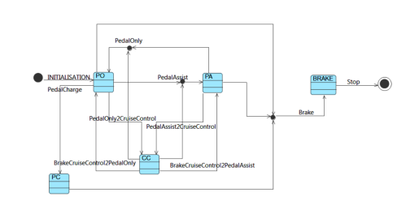
How is iUML-B used in the modelling of an e-Bike Cruise Control ?
The sequential processes and sub-processes are modelled using iUML-B state machines.
In order to refine the processes into smaller sequential steps, nested state-machines are used(which can be naturally introduced via refinement).

Slide 11
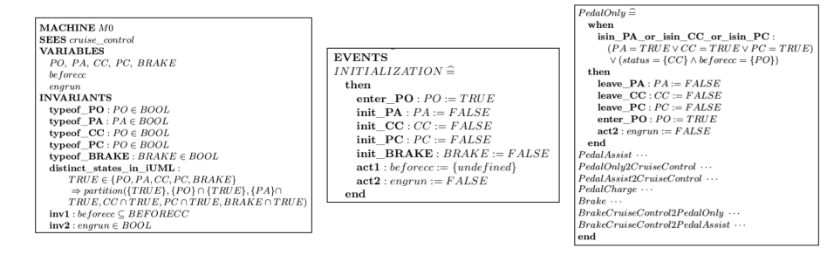
How is iUML-B used in the modelling of an e-Bike Cruise Control ?
Generated code using boolean variables for event PedalOnly is shown in the picture above. Each Event-B statement is preceded by its label which describes its purpose. For each state a type invariant is automatically generated in the Event-B machine.
For example, the type of state PO is defined in the invariant type of PO. For the states, an additional invariant distinct states in iUML is generated, stating that they are disjoint.

Slide 12
How is iUML-B used in the modelling of an e-Bike Cruise Control ?
For each transition there is a guard that specifies an instance source state (labelled as .. isin ..) and actions that specify its target state (labeled as .. enterState ..) and its departure from the current state (labelled as .. leaveState ..).
The other events are similarly defined. There is also a context cruise control added manually, which introduce the set BEFORECC used in the development.

Slide 13
ProB
ProB is an animation and model checking tool which accepts B-models, but is also integrated within the Rodin platform.
ProB supports automated consistency checking, which can be used to detect various errors in B specifications.
The animation facilities allow:
to visualize, at any moment, the state space
to execute a given number of operations
to see the shortest trace to current state

Slide 14
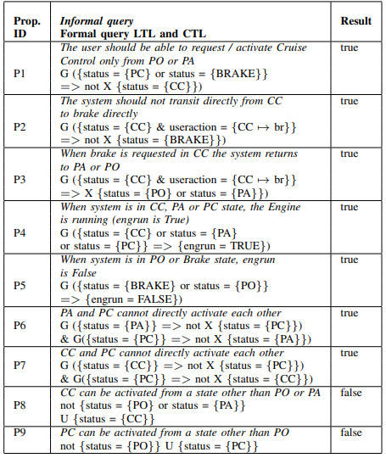
How is ProB used in the modelling of an e-Bike Cruise Control ?
Various properties of the eBike model are checked in order to verify that the model satisfies the system requirements using the ProB model checker.
P1 to P3 test transitions from/to the CC state.
P4 and P5 describe the behaviour of the system by identifying its states corresponding to the engine (usage of the battery) being on or off.
P6 and P7 check the existence/absence of transitions from/to PC.

Slide 15
How is ProB used in the modelling of an e-Bike Cruise Control ?
P8, which is false checks the existence of states (other than PO and PA) from which we may have direct access to the CC state. However, only PO and PA can access CC, so the property does not hold.
Property P9 asserts that PC can be activated from a state other than PO, whereas in fact only PO can activate PC. Therefore, it does not hold.
The verified properties validate that the e-Bike system works as desired.

Slide 16
Event-B machines
State transitions in the state machine become events in our B-machine.
INITIALIZATION:
PedalOnly,
PedalAssist
PedalOnly2CruiseControl
PedalAssist2CruiseControl
PedalCharge
BrakeBrakeCruiseControl2PedalOnly
BrakeCruiseControl2PedalAssist.
Guards are necessary conditions for an event to be enabled. When enabled, an event modifies the variables of the machine accordingly.

Slide 17
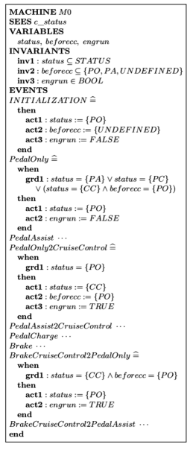
Event-B machines
The initial model (MACHINE M0) can then be refined by adding details about the state of the computation.
At the beginning of every step of maximal parallelism, the system is considered to be in state PO.

Slide 18
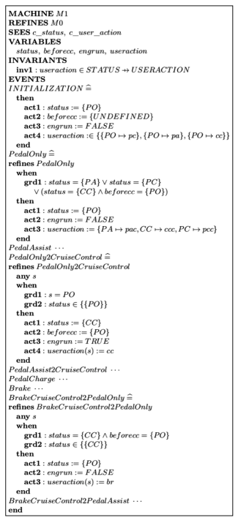
Event-B machines
In order to know the user action/request we refine (MACHINE M1) the original model by adding a variable useraction which is a function that associate a request with a target state.
The request has seven possible values: pa, pac, cc, pc, pcc, br and ccc defined in an enumerated set. pa = PA request, br = Brake request, ccc = CC cancel etc.
All the events in the original model have to be refined.

Slide 19
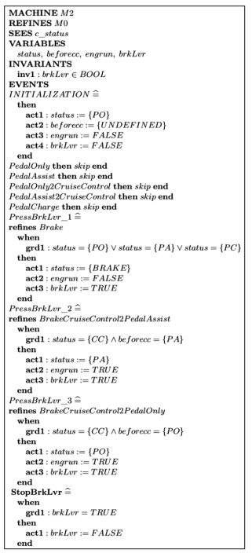
Event-B machines
Using brake lever causes permanent suspension of the system and this suspension can be resumed by the user.
We refine (MACHINE M2) the original model again by adding a boolean variable brkLvr to represent the brake lever.
The variable is set to TRUE when lever is pressed and to FALSE when is released.
We defined four events to represent actions of pressing and releasing the brake lever when the system is in CC state or not.

Slide 20
Event-B machines
The events:
PressBrkLvr 1
PressBrkLvr 2,
PressBrkLvr 3 updates the variable to TRUE and StopBrkLvr change the variable to FALSE.
Obviously, the useraction and variable brkLvr could have been introduced directly in the original model. However, the use of refinement allows a gradual, more manageable and natural, construction of the model.

Slide 21
Event-B machines
The parts omitted are similarly defined. At each refinement step we may introduce new variables and events or replace the abstract variables with the concrete ones (data refinement), thus incorporating more requirements into the model.
M1 and M2 machines are superposition refinement of the M0 machine. Aside from what is shown, there are two contexts c status and c user action, which introduce the sets used in the development

Slide 22
Conclusions
The cruise control system of e-Bike was the case study used. The e-Bike cruise control system was modelled using Rodin platform and validated its behaviour using the ProB tool.
The approach can be generalized so that it can be applied to a category of discrete systems.
If the behavior of a system is described by a state machine, one can use iUML plug-in to generate a (partial) formal model and later, depending on the specification, it is possible to deduce the contexts, axioms and invariants required for the description complete.

Slide 23
Conclusions
We used the information provided in the scientific paper to build our own formal model for a hybrid vehicle.
For this we applied the knowledge about EventB, Rodin, ProB, iUML-B and much more in order to create and validate the model for the vehicle.

Slide 24
Resources
S. -N. Predut, F. Ipate, M. Gheorghe and F. Campean, "Formal Modelling of Cruise Control System Using Event-B and Rodin Platform," 2018 IEEE 20th International Conference on High Performance Computing and Communications; IEEE 16th International Conference on Smart City; IEEE 4th International Conference on Data Science and Systems (HPCC/SmartCity/DSS), Exeter, UK, 2018, pp. 1541-1546, doi: 10.1109/HPCC/SmartCity/DSS.2018.00253.
https://wiki.event-b.org/index.php/IUML-B
http://www.event-b.org/
https://bookdown.org/rdpeng/artofdatascience/what-are-the-goals-of-formal-modeling.html

Slide 25
Thank you for your attention!

